Slide 1
English 2 July 16
Max Keenan

Slide 2
Attendance
Who is your favorite movie character and why?
Example: My favorite movie character is batman because he makes me feel like anyone can be a superhero. Also, he has a lot of cool gadgets and tools to help him fight bad guys.

Slide 3
Vocabulary Choice Board

Slide 4
1: Create Connections
Distress: when my rabbit is eaten
Improvement: want to be better
Disgust: when I see something disgusting
Suffocation: I can't breathe in the water when I swim
Listless: when I didn't sleep well last night
Pain: when I was injured in the ball
Outsider: when I go to someone else's wedding
Excluded: when they have anything full of me

Slide 5
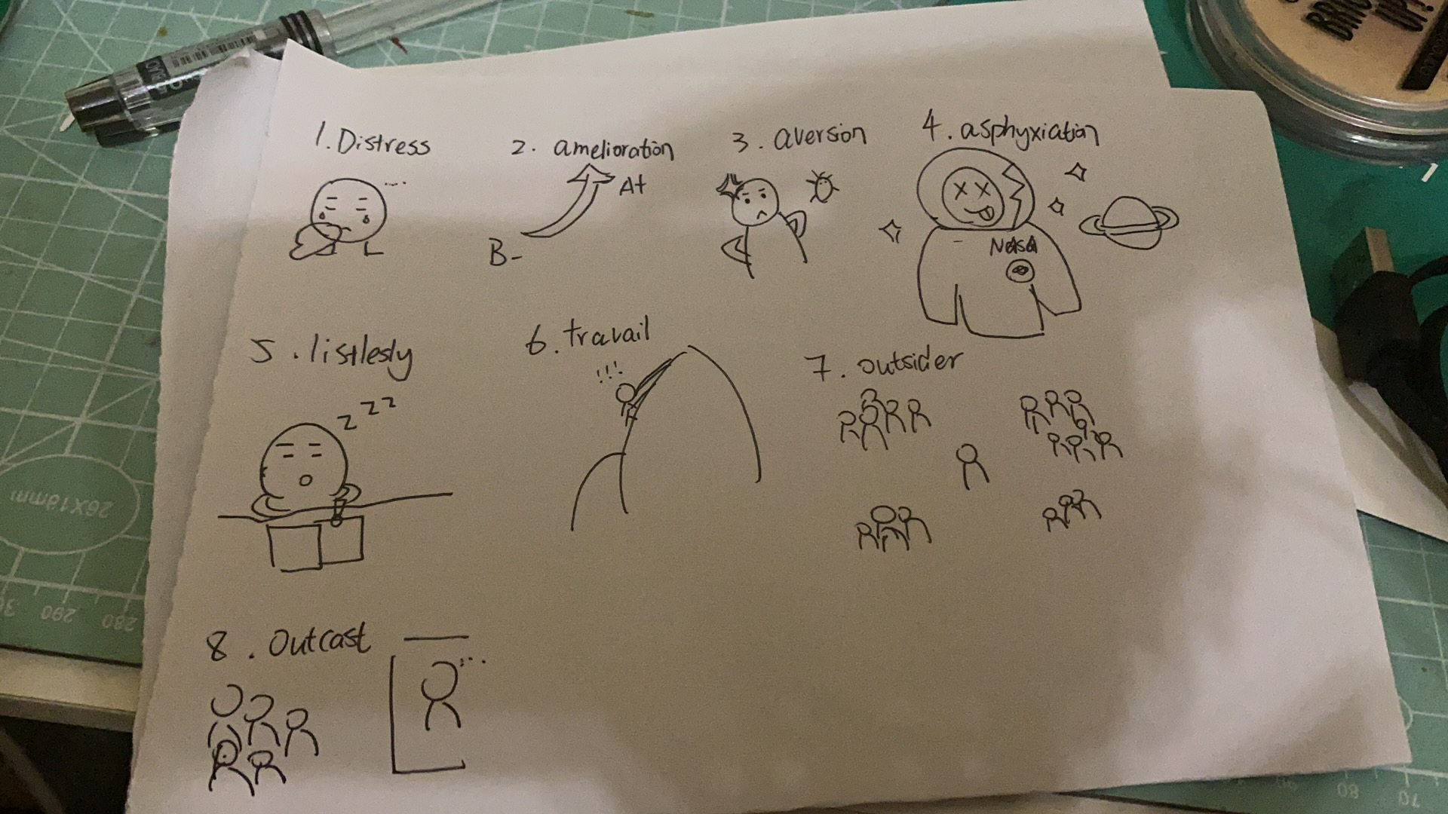
2: Illustrations

Slide 6
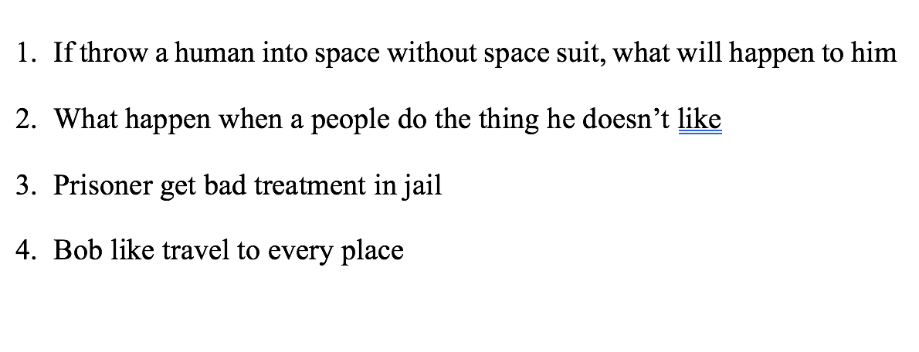
3: Riddle me this

Slide 7
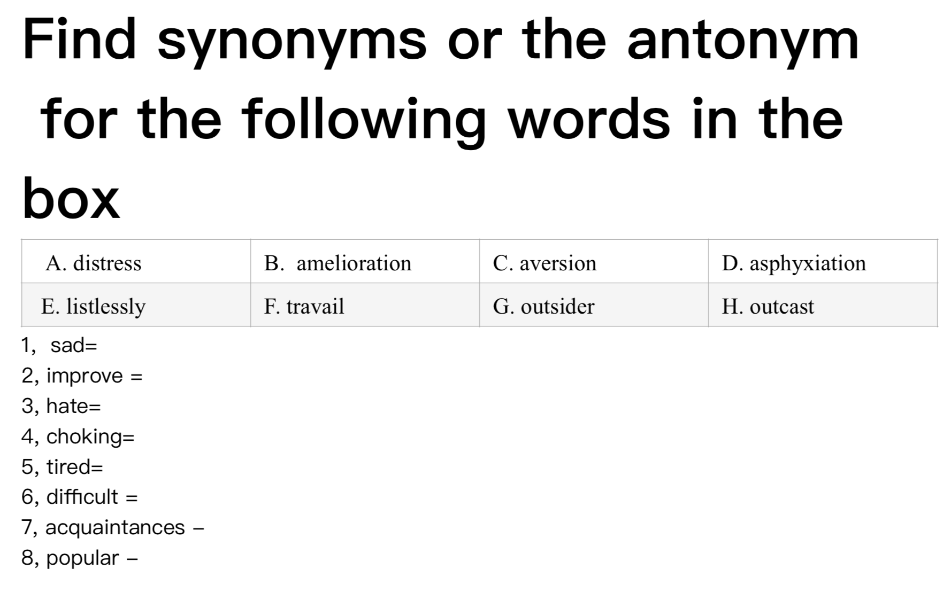
4: Quiz

Slide 8
5: Acrostic Poem
A void
V iolins
E very
R ound
S un
I s
O verly
N oxious

Slide 9
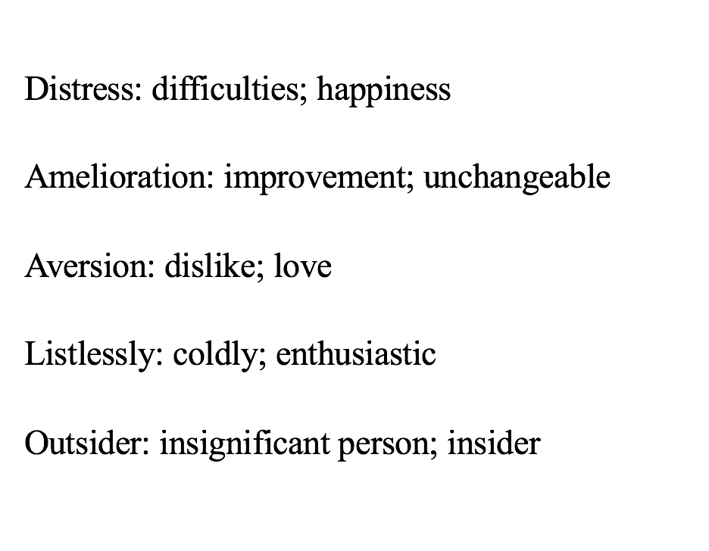
6: The same and the opposite

Slide 10
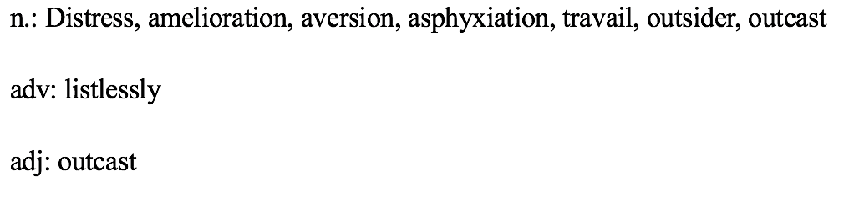
7: Sort it

Slide 11
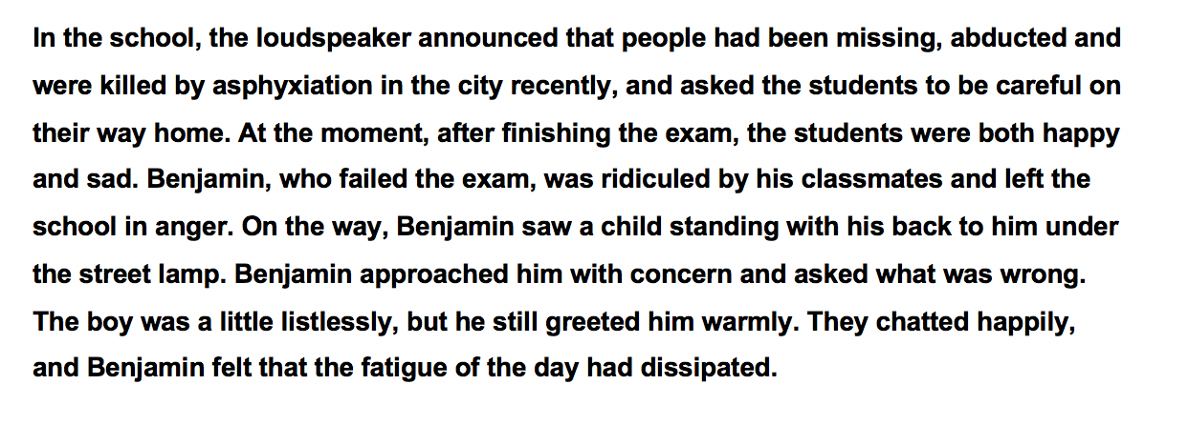

8: Write a story

Slide 12
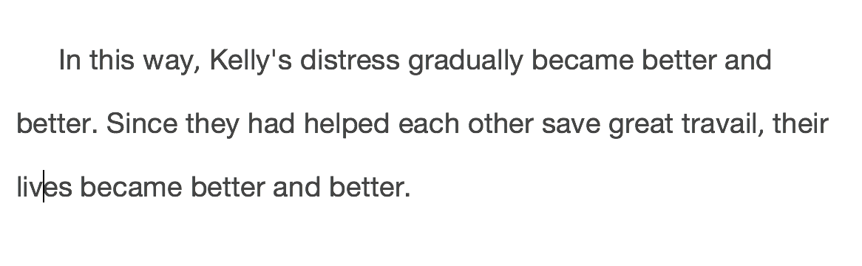

9: Write an article

Slide 13
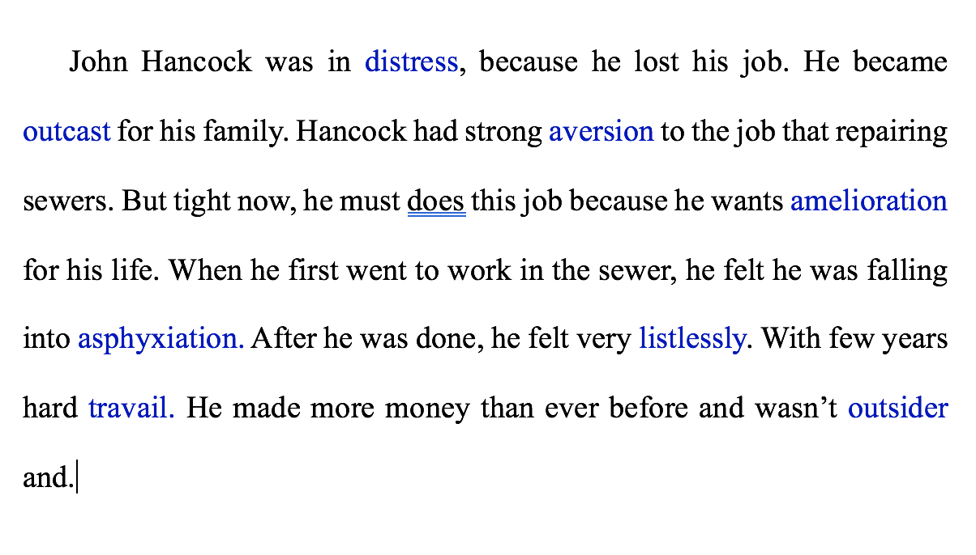
10: Super Sentences

Slide 14
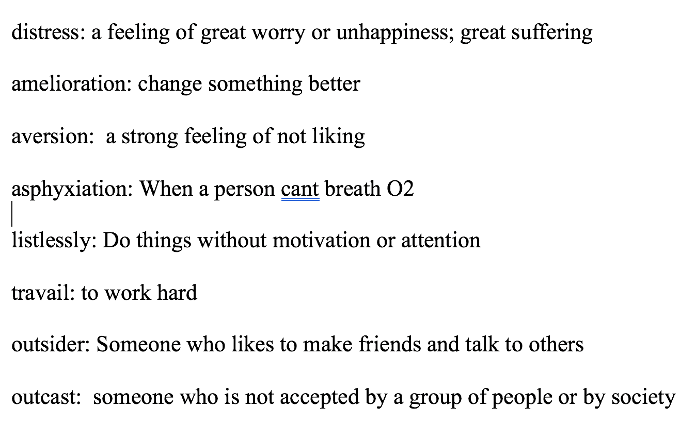
11: In your own words

Slide 15
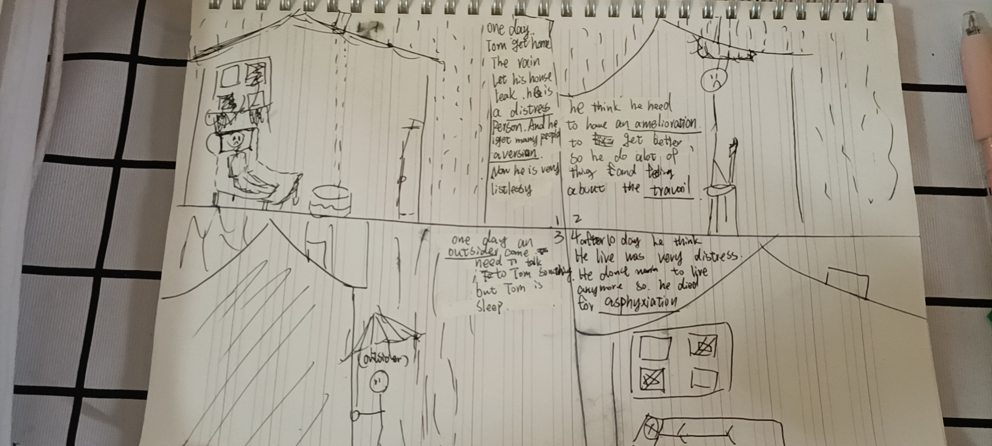
12: Comic strip

Slide 16
Types of phrases

Slide 17
Verb phrase (page 183): REVIEw
Metalanguage = are words used to talk about language. Words that describe language.
“noun” “verb” “grammar”
Verbs (3 kinds):
Action Verbs = words about movement/what people do.
Linking Verbs = connects parts of a sentence (be,…).
Helping Verbs (auxiliary verbs) = works together with an action verb to make the sentence clearer. ADDS meaning.

Slide 18
Verb phrase (page 183):
A verb phrase has a main verb and one or more helping verbs.
A helping verb provides more information like verb tense, mood, voice in a verb phrase
Common helping verbs are be, do, have, will, may, can, shall, must.
A verb phrase is ONLY the verbs, even if there is an aadverb inbetween it doesn’t count as part of the verb phrase.

Slide 19
Infinitive and Infinitive phrase (page 244)
Infinitive is a verb after the word “to” and it acts like a noun, adjective, or adverb.
to swim
Infinitive phrase is the word “to,” a verb, and everything after. This makes one part of speech.

Slide 20
Explanatory Essay Update (Gothic/Magical Realism)
3 students have not turned in their paper…
I will send back your grades this weekend.
A: You like your grade, you are done.
B: You DON’T like your grade, you can rewrite the paper (make adjustments according to my comments).

Slide 21
Outsiders/outcasts essay and presentation
Follow the writing guide to write your essay.
Prepare a short presentation about your essay for Monday in class.
Presentation can be a PPT, Speech, anything you like.

Slide 22
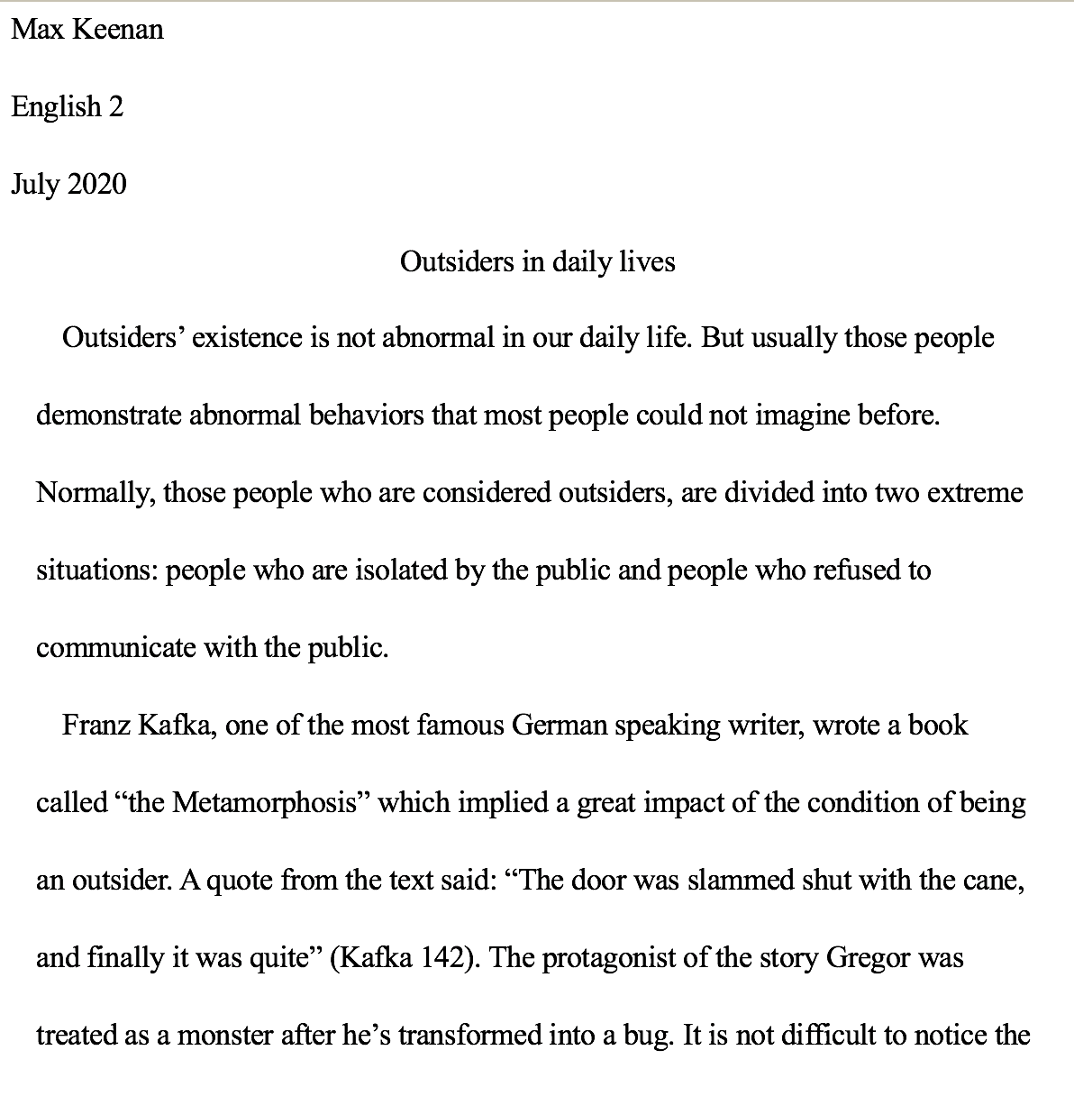

Slide 23
Example presentation

